Slide 1

Purdue University Northwest Hammond Computer Science CS 27500 Data Structures Section 1 Section 2 Fall 2024 Lecture 2 : Queues Muhammed Tawfiq Chowdhury mtawfiqc12@pnw.edu

Slide 2
What is a Queue?
A queue is a data structure collection of items in which only the earliest added item may be accessed. It is open at both ends. It is a close "cousin" of the stack, but a queue is a collection of objects that are added and removed according to the first-in, first-out (FIFO) principle.
That is, elements can be added at any time, but only the element that has been in the queue the longest can be next removed.
We usually say that elements enter a queue at the back and are removed from the front. A metaphor for this terminology is a line of people waiting to get on an amusement park ride. People waiting for such a ride enter at the back of the line and get on the ride from the front of the line. .
A queue would therefore be a logical choice for a data structure to handle calls to a customer service center, or a wait-list at a restaurant. FIFO queues are also used by many computing devices, such as a Web server responding to requests.

Slide 3

First In First Out: Queues
OUT
IN

Slide 4
Queue Operations: enqueue ()
ENQUEUE(Q, x)
Q.tail = Q.tail +1
Queue Tail
Queue Tail

Slide 5
Queue Operations: dequeue()
DEQUEUE(Q, x)
Q.head= Q.head +1
Queue Head
Queue Tail
Queue Head

Slide 6
Queue Operations: IsEmpty
IsEmpty
Q.head = Q.tail = - 1
Queue Head, Queue Tail

Slide 7
Queue Operations: IsFull
IsFull
Q.tail = n -1 or Maxsize
Queue Tail

Slide 8

Queue Operations: Front
Peek
Q.Head

Slide 9
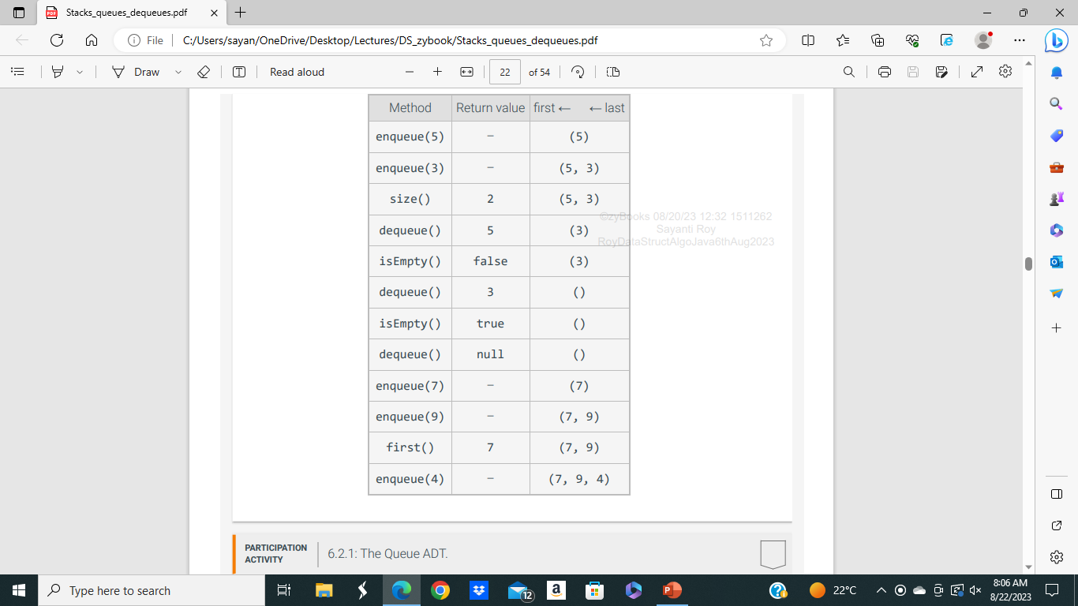

Slide 10
Types of Queues
Simple Queue: Simple queue is the most basic version of a queue. Here, insertion of an element i.e. the Enqueue operation takes place at the rear end and removal of an element i.e. the Dequeue operation takes place at the front end.
Circular Queue: In a circular queue, the element of the queue act as a circular ring. The working of a circular queue is similar to the linear queue except for the fact that the last element is connected to the first element. Its advantage is that the memory is utilized in a better way. This is because if there is an empty space i.e. if no element is present at a certain position in the queue, then an element can be easily added at that position.

Slide 11
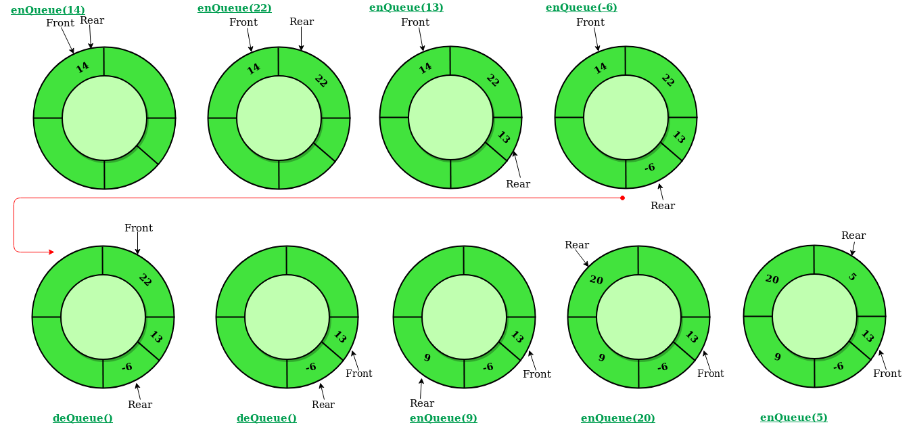
Circular Queue

Slide 12
Types of Queues
Priority Queue*: Its specialty is that it arranges the elements in a queue based on some priority. E.g., value of an element.
Deque*: Deque is also known as Double Ended Queue. As the name suggests double ended, it means that an element can be inserted or removed from both ends of the queue, unlike the other queues in which it can be done only from one end. Because of this property, it may not obey the First In First Out property. A double-ended queue, or deque, which is usually pronounced "deck" to avoid confusion with the dequeue method of the regular queue ADT, which is pronounced like the abbreviation “D.Q”.

Slide 13
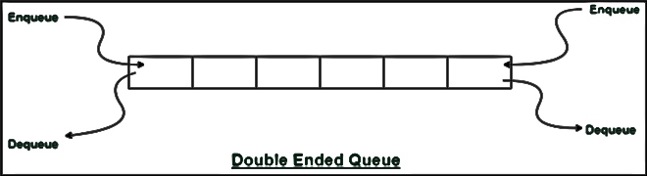
DEQUE
The extra generality can be useful in some applications. For example, we described a restaurant using a queue to maintain a waitlist. Occasionally, the first person might be removed from the queue only to find that a table was not available; typically, the restaurant will reinsert the person at the first position in the queue. It may also be that a customer at the end of the queue may grow impatient and leave the restaurant. (We will need an even more general data structure if we want to model customers leaving the queue from other positions.)

Slide 14
Deque
addFirst Add a new element at the front of the deque.
addLast Add a new element at the back of the deque.
removeFirst() Remove and return the first element of the deque (or null if the deque is empty).
removeLast() Remove and return the last element of the deque (or null if the deque is empty).
first() Returns the first element of the deque, without removing it (or null if the deque is
empty).
last() Returns the last element of the deque, without removing it (or null if the deque is
empty).
size() Returns the number of elements in the deque.
isEmpty() Returns a boolean indicating whether the deque is empty.

Slide 15
Queue vs Deque
1. A queue is a linear data structure that stores a collection of elements, with operations to enqueue (add) elements at the back of the queue, and dequeue (remove) elements from the front of the queue. A deque (double-ended queue) is a linear data structure that stores a collection of elements, with operations to add and remove elements from both ends of the deque.
2.Elements can only be inserted at the end of the data structure. Elements can be inserted from both ends of the data structure.
3.Elements can only be removed from the front of the data structure.Elements can be removed from both ends of the data structure.
4.Queues are a specialized data structure that uses the FIFO approach i.e., First In First Out. Deque can be used to implement the functionalities of both Stack (LIFO approach i.e., Last In First Out) and Queue (FIFO approach i.e., First In First Out).
5.A queue can be implemented using Array or Linked List. Deque can be implemented using Circular Array or Doubly Linked List.
6.Common queue operations include enqueue, dequeue, peek (return the front element without removing it), and size (return the number of elements in the queue).Common deque operations include addFirst (add an element to the front of the deque), addLast (add an element to the back of the deque), removeFirst (remove the first element from the deque), removeLast (remove the last element from the deque), peekFirst (return the first element without removing it), and peekLast (return the last element without removing it).

